Slide 1
Steps to do the MVC CRUD with Entity
Create Poco Class
Create AppDbcontext class which is child of DbContext class
Create interface with CRUD method
Create Service class which will implement interface. In this class inject child of DbContext class reference
Implement CRUD methods
Put connection string in Appsetting.json file
Configure services in program.cs file
Add-Migeration and update-Database
Add controller with read write action and modify code. Call method of service class
Write click on Action method and generate views.[list,details,delete,edit]

Slide 2
Dependancy Required for this project
.NET Core for developing web applications and APIs.
.NET Core provides the foundation and runtime for running any .NET Core application,
while ASP.NET Core extends .NET Core with web-specific features and tools.
Microsoft.EntityFrameworkCore
Microsoft.EntityFrameworkCore.SqlServer
Microsoft.EntityFrameworkCore.Tools
Microsoft.EntityFrameworkCore.Design
Microsoft.Extensions.Configuration.Json
dotnet tool install --global dotnet-ef
Dotnet ef
Install-Package Microsoft.EntityFrameworkCore
Install-Package Microsoft.EntityFrameworkCore.SqlServer
Install-Package Microsoft.EntityFrameworkCore.Tools
Install-Package Microsoft.EntityFrameworkCore.Design
Install-Package Microsoft.Extensions.Configuration.Json
Microsoft.VisualStudio.Web.CodeGeneration.Design

Slide 3
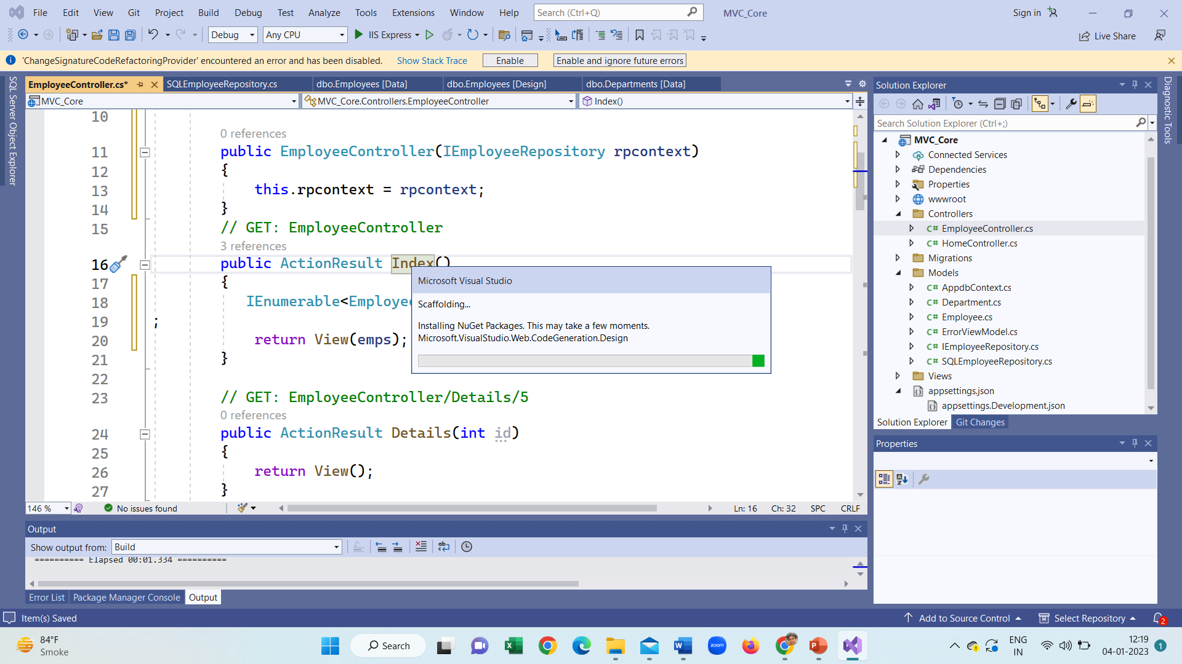

Slide 4
Models Folder has following classes
using System.Collections.Generic;
public class SQLEmployeeRepository: IEmployeeRepository
{
private readonly Appdbcontaxcts context;
public SQLEmployeeRepository(Appdbcontaxcts context)
{
this.context = context;
}
public Employee Add(Employee employee)
{
context.Employees.Add(employee);
context.SaveChanges();
return employee;
}
public Employee Delete(int Id)
{
Employee employee = context.Employees.Find(Id);
if (employee != null)
{
context.Employees.Remove(employee);
context.SaveChanges();
}
return employee;
}
public IEnumerable<Employee> GetAllEmployee()
{
return context.Employees;
}
public Employee GetEmployee(int Id)
{context.Employees.SingleOrDefault(data=>data.Id==Id)
return context.Employees.Find(Id);
}
public Employee Update(Employee employeeChanges)
{
context.Entry(employeeChanges).State = EntityState.Modified;
context.Update(employeeChanges);
context.SaveChanges();
return employeeChanges;
}
}
public interface IEmployeeRepository
{
Employee GetEmployee(int Id);
IEnumerable<Employee> GetAllEmployee();
Employee Add(Employee employee);
Employee Update(Employee employeeChanges);
Employee Delete(int Id);
}
Method of DbContext class
public class Employee
{
public int Id { get; set; }
public string Name { get; set; }
public string Email { get; set; }
public string Department { get; set; }
}
Query get fire when you call this method
use a Microsoft.EntityFrameworkCore.DbContextOptionsBuilder`1 to create instances
// of this class and it is not designed to be directly constructed in your application
// code.
using Microsoft.EntityFrameworkCore;
public class Appdbcontaxcts: DbContext
{
public Appdbcontaxcts(DbContextOptions<Appdbcontaxcts> options)
: base(options)
{
}
public DbSet<Employee> Employees { get; set; }
}
The DbContextOptions instance carries configuration information such as the connection string, database provider to use etc.
https://itnext.io/how-to-use-enums-when-using-entity-framework-core-with-c-bb634692a4b0

Slide 5
What is attach in Entity Framework?
Attach is used to repopulate a context with an entity that is known to already exist in the database. SaveChanges will therefore not attempt to insert an attached entity into the database because it is assumed to already be there.
What is the difference between attach and add in DbContext?
Add is to indicate to the Entity Framework that we are going to insert a new record in the database. In contrast, Entry and Attach are used in scenarios where the record already exists in the database, and we simply want to make some kind of modification on it.
When you do context.Entry(entity).State = EntityState.Modified;, you are not only attaching the entity to the DbContext, you are also marking the whole entity as dirty. This means that when you do context.SaveChanges(), EF will generate an update statement that will update all the fields of the entity.
This is not always desired.
On the other hand, DbSet.Attach(entity) attaches the entity to the context without marking it dirty. It is equivalent to doing context.Entry(entity).State = EntityState.Unchanged;
When attaching this way, unless you then proceed to update a property on the entity, the next time you call context.SaveChanges(), EF will not generate a database update for this entity.
Even if you are planning on making an update to an entity, if the entity has a lot of properties (db columns) but you only want to update a few, you may find it advantageous to do a DbSet.Attach(entity), and then only update the few properties that need updating. Doing it this way will generate a more efficient update statement from EF. EF will only update the properties you modified (in contrast to context.Entry(entity).State = EntityState.Modified; which will cause all properties/columns to be updated)
DbSet.Attach(entity) vs DbContext.Entry(entity).State = EntityState.Modified

Slide 6
6.0.0
var builder = WebApplication.CreateBuilder(args);
// Add services to the container.
builder.Services.AddControllersWithViews();
builder.Services.AddDbContextPool<Appdbcontexts>(
options => options.UseSqlServer(builder.Configuration.GetConnectionString("EmployeeDBConnection")));
builder.Services.AddScoped<IEmployeeRepository, SqlemployeeRepository>();
var app = builder.Build();
// Configure the HTTP request pipeline.
if (!app.Environment.IsDevelopment())
{
app.UseExceptionHandler("/Home/Error");
// The default HSTS value is 30 days. You may want to change this for production scenarios, see https://aka.ms/aspnetcore-hsts.
app.UseHsts();
}
app.UseHttpsRedirection();
app.UseStaticFiles();
app.UseRouting();
app.UseAuthorization();
app.MapControllerRoute(
name: "default",
pattern: "{controller=Home}/{action=Index}/{id?}");
app.Run();
Appsettings.json
{
"Logging": {
"LogLevel": {
"Default": "Information",
"Microsoft": "Warning",
"Microsoft.Hosting.Lifetime": "Information"
}
},
"ConnectionStrings": {
"EmployeeDBConnection":"Data Source=(localdb)\\Projects;Initial Catalog=demodb;Integrated Security=True"
},
"AllowedHosts": "*"
}

Slide 7
Add-Migration
add-migration CreateDemodb
update-database –verbose
This will show all ADO.Net command
It is use full for checking error

Slide 8
Interface
Service_Class Implement Interface
Inject contextclass
Communicate to Context class
Class Contoller
Inject interface reference
This class communicate to Service class
Get the result and return view
View
Display strongly type data in browser.
Class appDbContext:DbContext
This class will communicate to database
Program.cs file
Configure all services

Slide 9
using Microsoft.AspNetCore.Http;
using Microsoft.AspNetCore.Mvc;
using WebAppSqlRepo.Models;
namespace WebAppSqlRepo.Controllers
{
public class EmployeeController : Controller
{
private IEmployeeRepository _employeeRepository;
public EmployeeController(IEmployeeRepository employeeRepository)
{
_employeeRepository = employeeRepository;
}
// GET: EmployeeController
public ActionResult Index()
{
var model = _employeeRepository.GetAllEmployee();
return View(model);
}
// GET: EmployeeController/Details/5
public ActionResult Details(int id)
{
var model = _employeeRepository.GetEmployee(id);
return View(model);
}
// GET: EmployeeController/Create
public ActionResult Create()
{
return View();
}
// POST: EmployeeController/Create
[HttpPost]
[ValidateAntiForgeryToken]
public ActionResult Create(Employee employee)
{ try
{
var model = _employeeRepository.Add(employee);
return RedirectToAction(nameof(Index));
}
catch
{
return View();
}
}
// GET: EmployeeController/Edit/5
public ActionResult Edit(int id)
{
var model = _employeeRepository.GetEmployee(id);
return View(model);
}
// POST: EmployeeController/Edit/5
[HttpPost]
[ValidateAntiForgeryToken]
public ActionResult Edit(int id, Employee emp)
{
try
{
var model = _employeeRepository.Update(emp);
return RedirectToAction(nameof(Index));
}
catch
{
return View();
}
}
// GET: EmployeeController/Delete/5
public ActionResult Delete(int id)
{
var model = _employeeRepository.GetEmployee(id);
return View(model);
}
// POST: EmployeeController/Delete/5
[HttpPost]
[ValidateAntiForgeryToken]
public ActionResult Delete(int id, IFormCollection collection)
{
try
{
var model = _employeeRepository. .Delete(id);
return RedirectToAction(nameof(Index));
}
catch
{
return View();
}
}
}
}

Slide 10
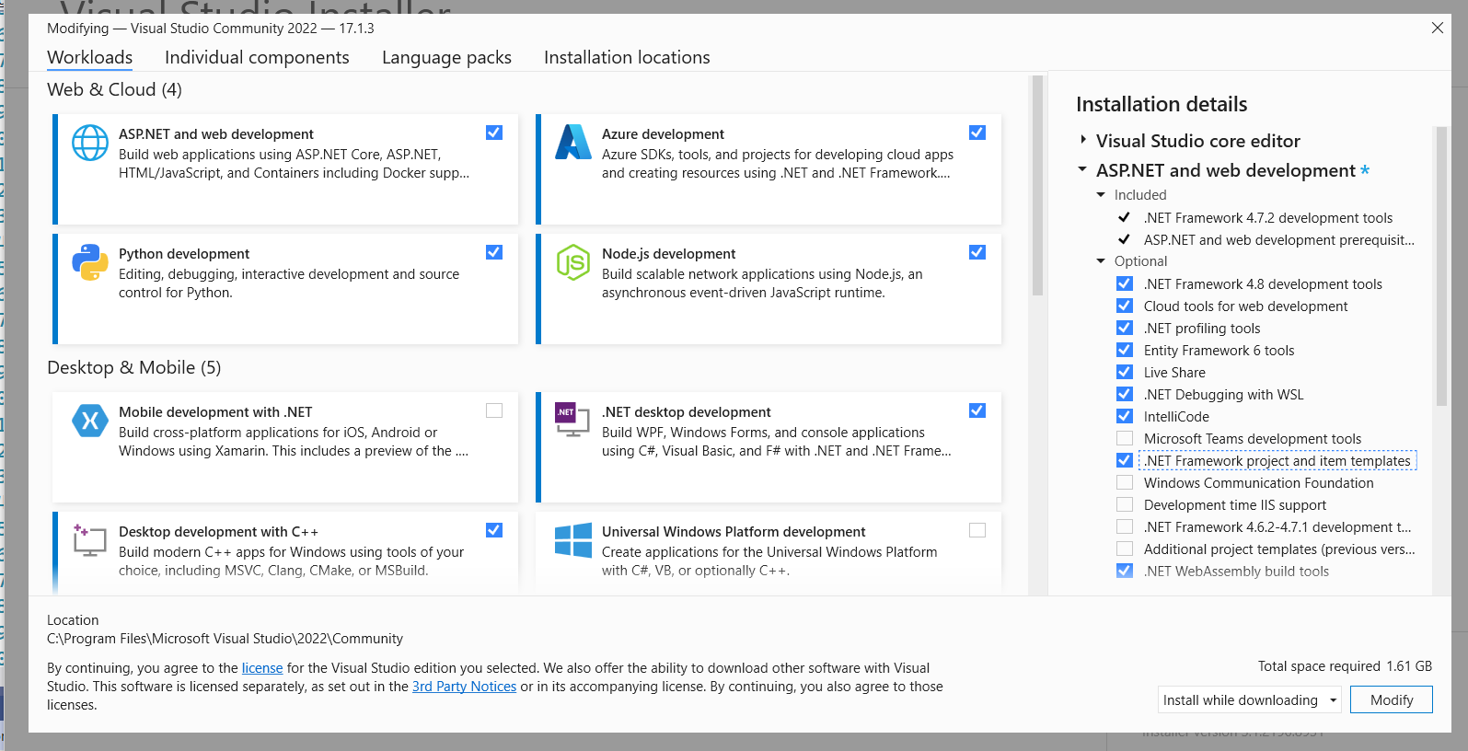
If Read write with entity framework does not work

Slide 11
View➔Index
@model IEnumerable<MVC_Core.Models.Employee>
@{
ViewData["Title"] = "Index";
}
<h1>Index</h1>
<p>
<a asp-action="Create">Create New</a>
</p>
<table class="table">
<thead>
<tr>
<th>
@Html.DisplayNameFor(model => model.Name)
</th>
<th>
@Html.DisplayNameFor(model => model.Email)
</th>
<th>
@Html.DisplayNameFor(model => model.Department)
</th>
<th></th>
</tr>
</thead>
<tbody>
@foreach (var item in Model) {
<tr>
<td>
@Html.DisplayFor(modelItem => item.Name)
</td>
<td>
@Html.DisplayFor(modelItem => item.Email)
</td>
<td>
@Html.DisplayFor(modelItem => item.Department)
</td>
<td>
<a asp-action="Edit" asp-route-id="@item.Id">Edit</a> |
<a asp-action="Details" asp-route-id="@item.Id">Details</a> |
<a asp-action="Delete" asp-route-id="@item.Id">Delete</a>
</td>
</tr>
}
</tbody>
</table>

Slide 12
View➔Detail
@model MVC_Core.Models.Employee
@{
ViewData["Title"] = "Details";
}
<h1>Details</h1>
<div>
<h4>Employee</h4>
<hr />
<dl class="row">
<dt class = "col-sm-2">
@Html.DisplayNameFor(model => model.Name)
</dt>
<dd class = "col-sm-10">
@Html.DisplayFor(model => model.Name)
</dd>
<dt class = "col-sm-2">
@Html.DisplayNameFor(model => model.Email)
</dt>
<dd class = "col-sm-10">
@Html.DisplayFor(model => model.Email)
</dd>
<dt class = "col-sm-2">
@Html.DisplayNameFor(model => model.Department)
</dt>
<dd class = "col-sm-10">
@Html.DisplayFor(model => model.Department)
</dd>
</dl>
</div>
<div>
<a asp-action="Edit" asp-route-id="@Model?.Id">Edit</a> |
<a asp-action="Index">Back to List</a>
</div>

Slide 13
View➔Create
@model MVC_Core.Models.Employee
@{
ViewData["Title"] = "Create";
}
<h1>Create</h1>
<h4>Employee</h4>
<hr />
<div class="row">
<div class="col-md-4">
<form asp-action="Create">
<div asp-validation-summary="ModelOnly" class="text-danger"></div>
<div class="form-group">
<label asp-for="Name" class="control-label"></label>
<input asp-for="Name" class="form-control" />
<span asp-validation-for="Name" class="text-danger"></span>
</div>
<div class="form-group">
<label asp-for="Email" class="control-label"></label>
<input asp-for="Email" class="form-control" />
<span asp-validation-for="Email" class="text-danger"></span>
</div>
<div class="form-group">
<label asp-for="Department" class="control-label"></label>
<input asp-for="Department" class="form-control" />
<span asp-validation-for="Department" class="text-danger"></span>
</div>
<div class="form-group">
<input type="submit" value="Create" class="btn btn-primary" />
</div>
</form>
</div>
</div>
<div>
<a asp-action="Index">Back to List</a>
</div>
@section Scripts {
@{await Html.RenderPartialAsync("_ValidationScriptsPartial");}
}

Slide 14
View➔Edit
@model MVC_Core.Models.Employee
@{
ViewData["Title"] = "Edit";
}
<h1>Edit</h1>
<h4>Employee</h4>
<hr />
<div class="row">
<div class="col-md-4">
<form asp-action="Edit">
<div asp-validation-summary="ModelOnly" class="text-danger"></div>
<input type="hidden" asp-for="Id" />
<div class="form-group">
<label asp-for="Name" class="control-label"></label>
<input asp-for="Name" class="form-control" />
<span asp-validation-for="Name" class="text-danger"></span>
</div>
<div class="form-group">
<label asp-for="Email" class="control-label"></label>
<input asp-for="Email" class="form-control" />
<span asp-validation-for="Email" class="text-danger"></span>
</div>
<div class="form-group">
<label asp-for="Department" class="control-label"></label>
<input asp-for="Department" class="form-control" />
<span asp-validation-for="Department" class="text-danger"></span>
</div>
<div class="form-group">
<input type="submit" value="Save" class="btn btn-primary" />
</div>
</form>
</div>
</div>
<div>
<a asp-action="Index">Back to List</a>
</div>
@section Scripts {
@{await Html.RenderPartialAsync("_ValidationScriptsPartial");}
}

Slide 15
@model MVC_Core.Models.Employee
@{
ViewData["Title"] = "Delete";
}
<h1>Delete</h1>
<h3>Are you sure you want to delete this?</h3>
<div>
<h4>Employee</h4>
<hr />
<dl class="row">
<dt class = "col-sm-2">
@Html.DisplayNameFor(model => model.Name)
</dt>
<dd class = "col-sm-10">
@Html.DisplayFor(model => model.Name)
</dd>
<dt class = "col-sm-2">
@Html.DisplayNameFor(model => model.Email)
</dt>
<dd class = "col-sm-10">
@Html.DisplayFor(model => model.Email)
</dd>
<dt class = "col-sm-2">
@Html.DisplayNameFor(model => model.Department)
</dt>
<dd class = "col-sm-10">
@Html.DisplayFor(model => model.Department)
</dd>
</dl>
<form asp-action="Delete">
<input type="hidden" asp-for="Id" />
<input type="submit" value="Delete" class="btn btn-danger" /> |
<a asp-action="Index">Back to List</a>
</form>
</div>

Slide 16
using Microsoft.AspNetCore.Http;
using Microsoft.AspNetCore.Mvc;
using MVC_Core.Models;
namespace MVC_Core.Controllers
{
public class EmployeeController : Controller
{
private readonly IEmployeeRepository rpcontext;
public EmployeeController(IEmployeeRepository rpcontext)
{
this.rpcontext = rpcontext;
}
// GET: EmployeeController
public ActionResult Index()
{
IEnumerable<Employee> emps= rpcontext.GetAllEmployee()
;
return View(emps);
}
// GET: EmployeeController/Details/5
public ActionResult Details(int id)
{
Employee e1= rpcontext.GetEmployee(id);
return View(e1);
}
// GET: EmployeeController/Create
public ActionResult Create()
{
return View();
}
// POST: EmployeeController/Create
[HttpPost]
[ValidateAntiForgeryToken]
public ActionResult Create(Employee emp)
{
try
{
if (ModelState.IsValid)
{
rpcontext.Add(emp);
return RedirectToAction(nameof(Index));
}
else { return View(); }
}
catch
{
return View();
}
}
// GET: EmployeeController/Edit/5
public ActionResult Edit(int id)
{
Employee e1 = rpcontext.GetEmployee(id);
return View(e1);
}
// POST: EmployeeController/Edit/5
[HttpPost]
[ValidateAntiForgeryToken]
public ActionResult Edit(int id, Employee emp)
{
try
{
if (id == emp.Id )
{
if (ModelState.IsValid)
{
rpcontext.Update(emp);
return RedirectToAction(nameof(Index));
}
}
}
catch
{
return View();
}
return View();
}
// GET: EmployeeController/Delete/5
public ActionResult Delete(int id)
{
Employee e1 = rpcontext.GetEmployee(id);
return View(e1);
}
// POST: EmployeeController/Delete/5
[HttpPost]
[ValidateAntiForgeryToken]
public ActionResult Delete(int id, Employee emp)
{
rpcontext.Delete(id);
return RedirectToAction(nameof(Index));
}
}
}

Slide 17
PM> Install-Package Microsoft.VisualStudio.Web.CodeGeneration.Design -Version 5.0.0
Down load all DLL file
Create poco class
Create Appdbcontextclass
Put connection string Appsetting.json
Write SqlServerRepository➔ implementation class
Create controller
Inject Interface reference
Following command to be written at Package Manager Console
9. Add-Migration
10. Update-Database –verbose
11. Add data in database
12. Generate all view

Slide 18
public class EmployeesController : Controller
{
private readonly Appdbcontaxcts _context;
public EmployeesController(Appdbcontaxcts context)
{
_context = context;
}
// GET: Employees
public async Task<IActionResult> Index()
{
return View(await _context.Employees.ToListAsync());
}
// GET: Employees/Details/5
public async Task<IActionResult> Details(int? id)
{
if (id == null)
{
return NotFound();
}
var employee = await _context.Employees
.FirstOrDefaultAsync(m => m.Id == id);
if (employee == null)
{
return NotFound();
}
return View(employee);
}
// GET: Employees/Create
public IActionResult Create()
{
return View();
}
// POST: Employees/Create
// To protect from overposting attacks, enable the specific properties you want to bind to, for
// more details, see http://go.microsoft.com/fwlink/?LinkId=317598.
[HttpPost]
[ValidateAntiForgeryToken]
public async Task<IActionResult> Create([Bind("Id,Name,Email,Department")] Employee employee)
{
if (ModelState.IsValid)
{
_context.Add(employee);
await _context.SaveChangesAsync();
return RedirectToAction(nameof(Index));
}
return View(employee);
}
// GET: Employees/Edit/5
public async Task<IActionResult> Edit(int? id)
{
if (id == null)
{
return NotFound();
}
var employee = await _context.Employees.FindAsync(id);
if (employee == null)
{
return NotFound();
}
return View(employee);
}
// POST: Employees/Edit/5
// To protect from overposting attacks, enable the specific properties you want to bind to, for
// more details, see http://go.microsoft.com/fwlink/?LinkId=317598.
[HttpPost]
[ValidateAntiForgeryToken]
public async Task<IActionResult> Edit(int id, [Bind("Id,Name,Email,Department")] Employee employee)
{
if (id != employee.Id) {
return NotFound();
}
if (ModelState.IsValid) {
try{ _context.Update(employee);
await _context.SaveChangesAsync();
}
catch (DbUpdateConcurrencyException) {
if (!EmployeeExists(employee.Id)) {
return NotFound();
}
else {
throw;
}
}
return RedirectToAction(nameof(Index));
}
return View(employee);
}
// GET: Employees/Delete/5
public async Task<IActionResult> Delete(int? id)
{
if (id == null) {
return NotFound();
}
var employee = await _context.Employees
.FirstOrDefaultAsync(m => m.Id == id);
if (employee == null) {
return NotFound();
}
return View(employee);
}
// POST: Employees/Delete/5
[HttpPost, ActionName("Delete")]
[ValidateAntiForgeryToken]
public async Task<IActionResult> DeleteConfirmed(int id) {
var employee = await _context.Employees.FindAsync(id);
_context.Employees.Remove(employee);
await _context.SaveChangesAsync();
return RedirectToAction(nameof(Index));
}
private bool EmployeeExists(int id) {
return _context.Employees.Any(e => e.Id == id);
}
}
}

